Slide 1


Sales Insights - Data Analysis Project using Tableau
By – shankhin poovanna

Slide 2
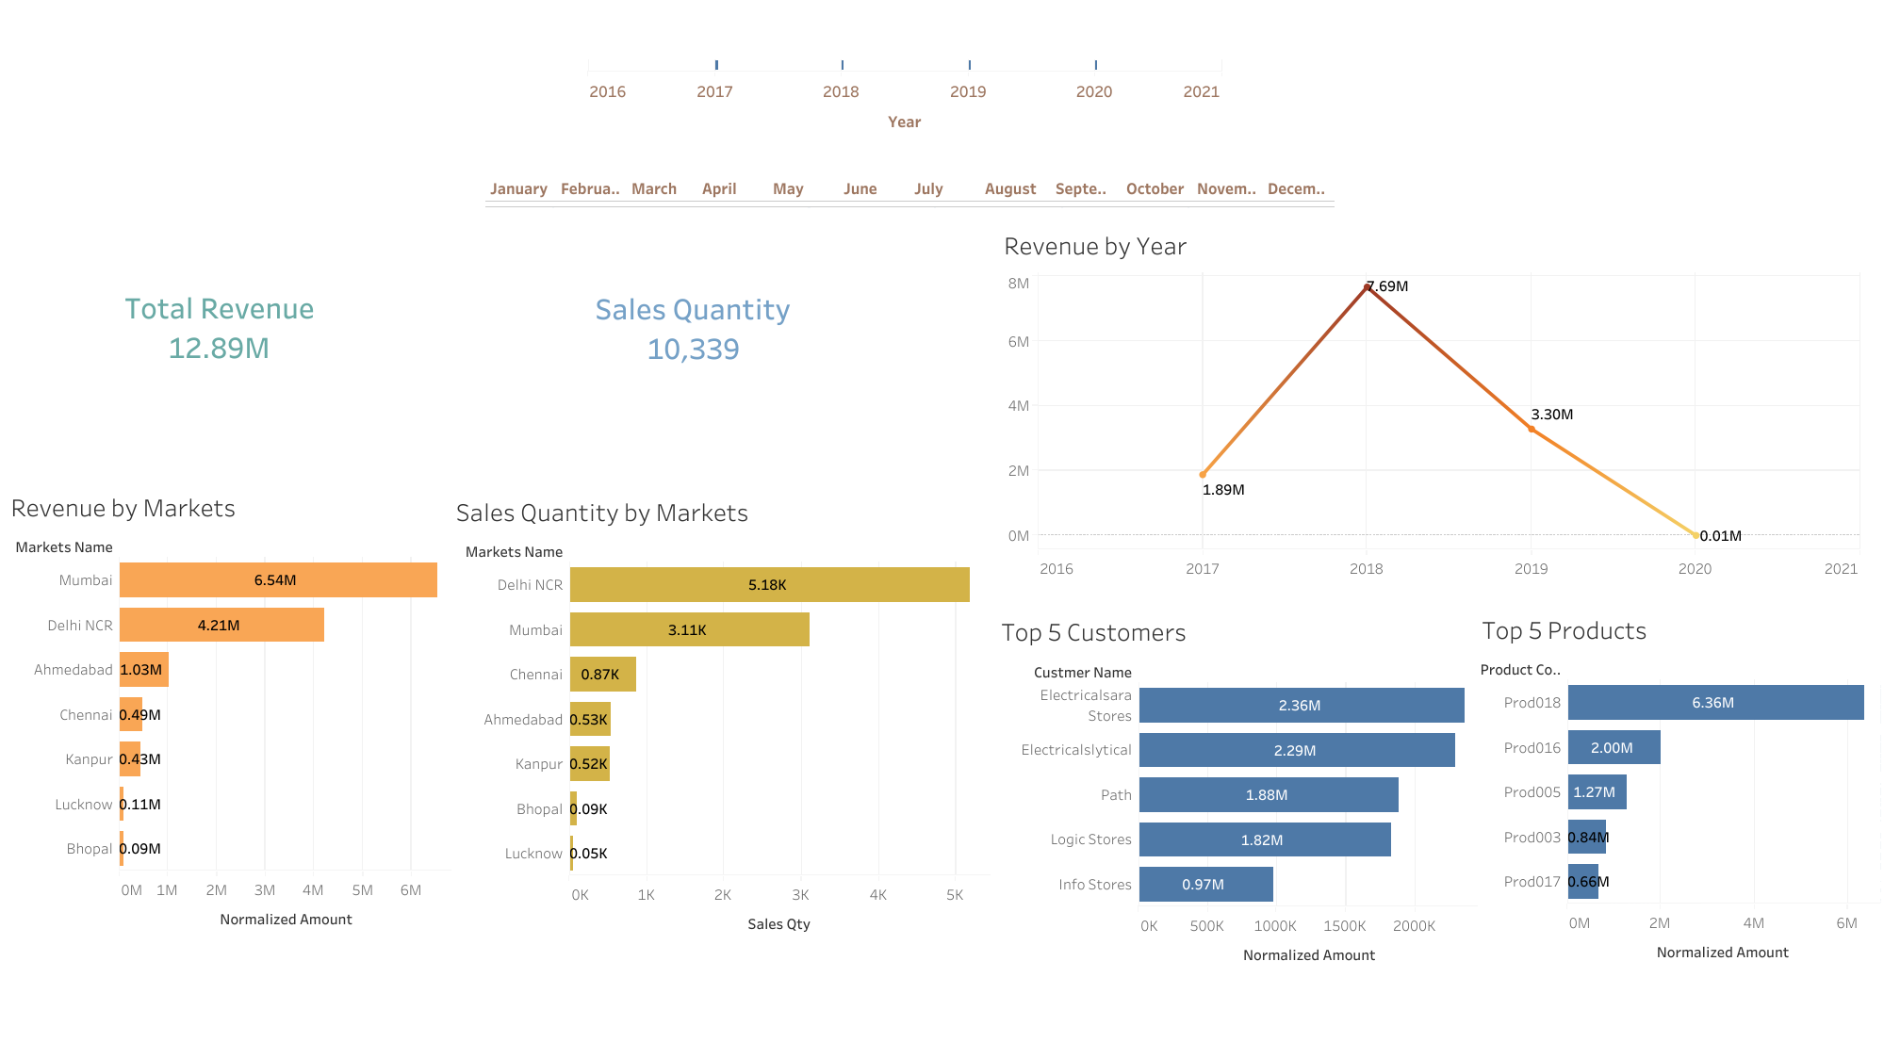

Slide 3
